Slide 1

Global Warming
Tigergraph with Machine Learning

Slide 2
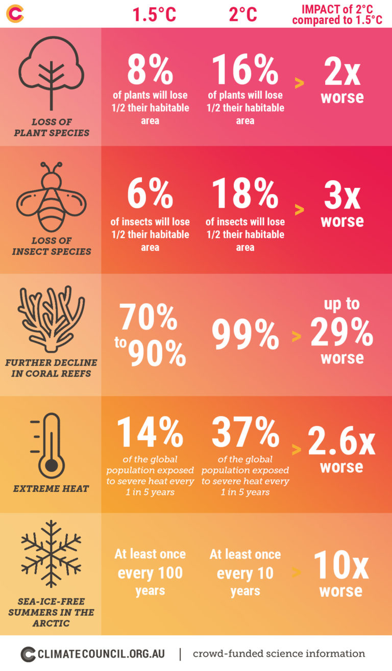
Every point-of-a-degree Matters
At the rate we're going, we've got around 10 years until we hit 1.5C.
IPCC finds that limiting warming to 1.5C requires global emissions to be slashed by 45 per cent by 2030, compared to 2010 levels
It's exceedingly unlikely that we will manage to limit warming to below 1.5C without overshoot
We can expect an average of about 56 centimetres of sea level rise this century at 2C — but up to 96cm in the worst-case scenario
That extra 0.5C, according to the IPCC, is expected to impact an extra 10.4 million people

Slide 3
Why we need this solution ?
Global warming is very critical challenge , we humans are the ones who burn fossil fuels and chop down forests, causing average temperatures to rise worldwide.
That global warming trend is increasingly disrupting our climate — the average weather over many years.
Created 2 stage approach to combine Tigergraph with machine learning to help track , understand relationship and highlight any anomalies in this overall trend
Though as part of this challenge started with 4 datasets with monthly granularity but idea is to use this approach for real time per minute , hourly or daily datasets
Forecasted values from Machine Learning model can be use to understand any anomalies in Carbon Emission , Temperature Anomaly , Ocean Heat and Arctic sea ice extent by comparing against actual captured values as its very critical to understand if we heading in right direction or not

Slide 4
How tigergrpah with machine learning can help?
Stage-1 : Started with 4 different timeseries datasets related to global warming to understand the impact of Carbon Emission on Temperature Anomaly , Ocean Heat and Arctic sea ice extent
  CO2 : Global Carbon Emission
  Temperature Anomaly : Change in global surface temperature relative to 1951-1980 average temperature
  Ocean Heat : Ocean heat content change since 1992
  Arctic sea ice extent : Annual Arctic sea ice minimum since 1979, based on satellite observations
Currently using monthly datapoints but same graph an be extended to use hourly or daily datapoints as well

Slide 5
How tigergrpah with machine learning can help?
Stage-2 : Used tigergrpah as data source to Regression model post understanding relationship between different datapoints mentioned in stage-1
  Model-1: Timeseries forecast to predict Carbon Emission based on historical datapoints
  Model-2:
    Built Regression model with Carbon Emission as independent variable and Temperature Anomaly , Ocean Heat and Arctic sea ice extent as dependent variables
    Used Model-1 forecasted Carbon Emission to forecast future Temperature Anomaly , Ocean Heat and Arctic sea ice extent
Output values from Model-2 can be use to understand any anomalies by comparing against actual captured values . Critical to understand if we heading in right direction or not
This model currently using monthly datapoints but this same model can be used for hourly or daily data samples as well.

Slide 6
Platform , tools and languages
Tigergraph Cloud Based Graph Database : An easy-to-use, cloud-based graph database built for agile teams.
Google Collaboratory : Colab allows anybody to write and execute arbitrary python code through the browser
PyCharm / Python : To build Machine learning model
Scikit-learn : Regression model python library
Data: All data is collected from NASA Global Climate Change https://climate.nasa.gov/

Slide 7
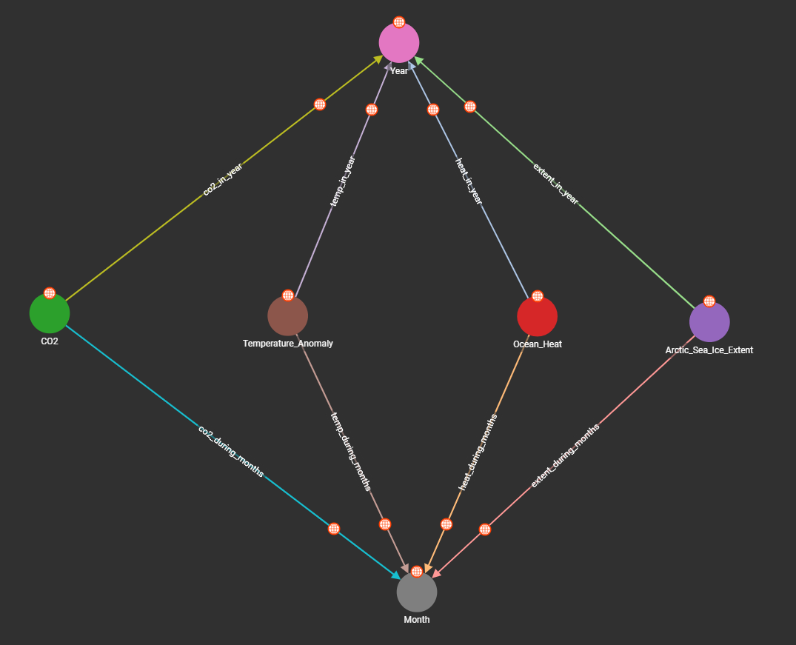
TIGERGRAPH DESIGN SCHEMA

Slide 8
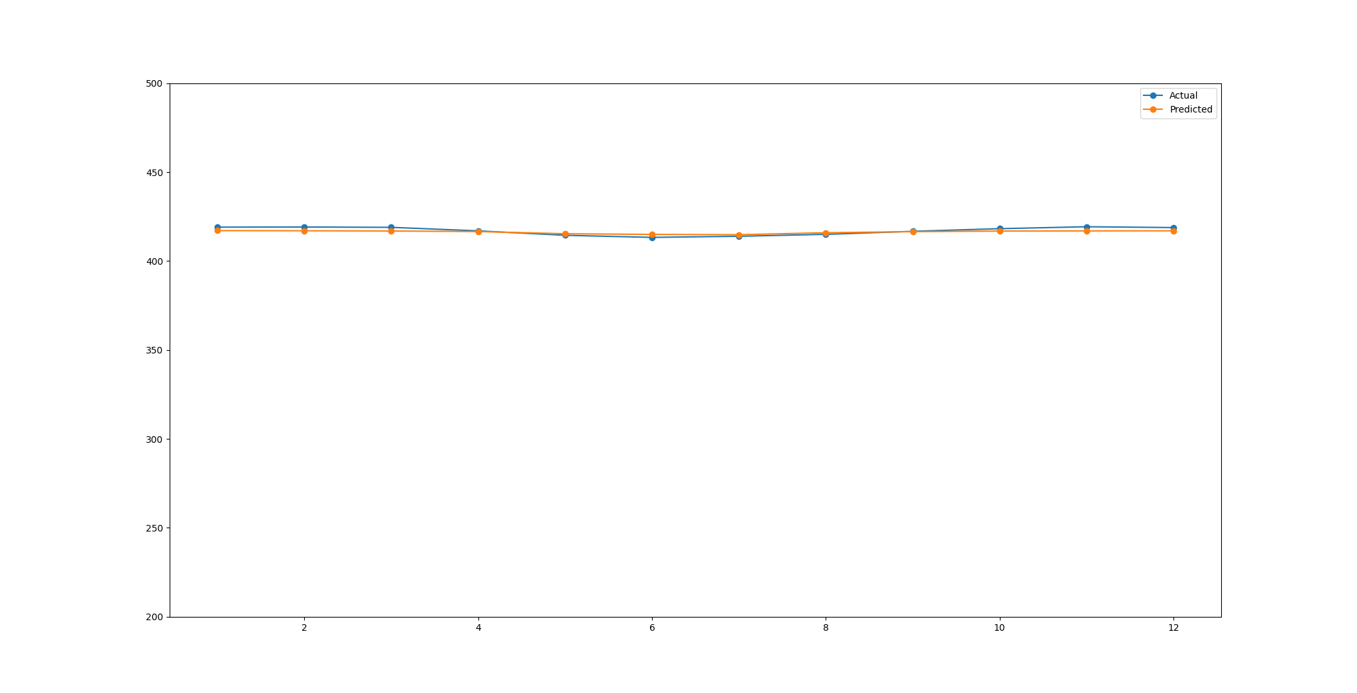
Machine Learning (Carbon Emission Time series Forecast)
Root Mean Squared Error: 1.5406
RMSE of 1.5406 with CO2 values in range of 410-420
Validation set proves the forecasting of Carbon Emission time series data

Slide 9
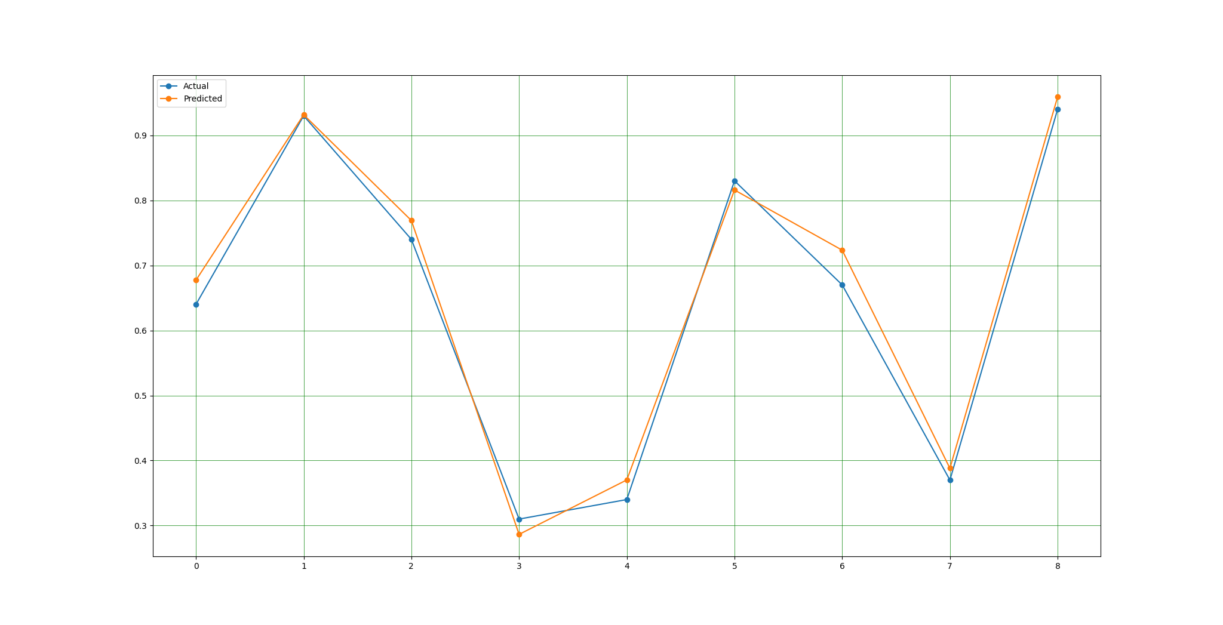
Machine Learning (Temperature Anomaly Forecast)
Root Mean Squared Error: 0.0287
Variance score: 0.98
R2 value of 0.98 which is very close to 1 with root mean squared error of only 0.0287
Proves strong relationship between Carbon Emission and Tempature Anomaly

Slide 10
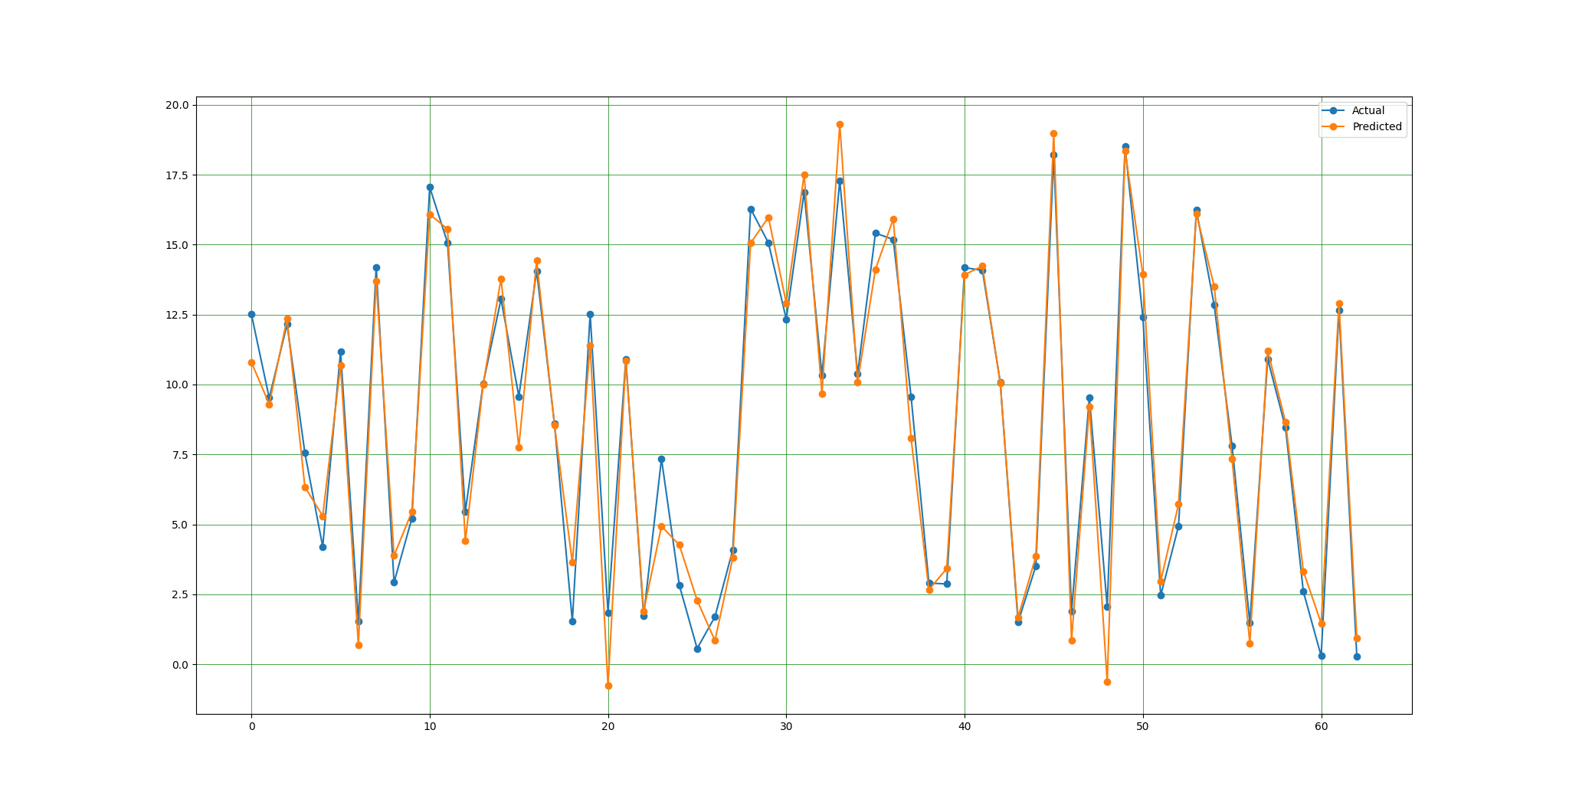
Machine Learning (Ocean Heat Forecast)
Root Mean Squared Error: 1.03074
Variance score: 0.97
R2 value of 0.97 which is very close to 1 with root mean squared error of only 0.3281
Proves strong relationship between Carbon Emission and Ocean Heat

Slide 11
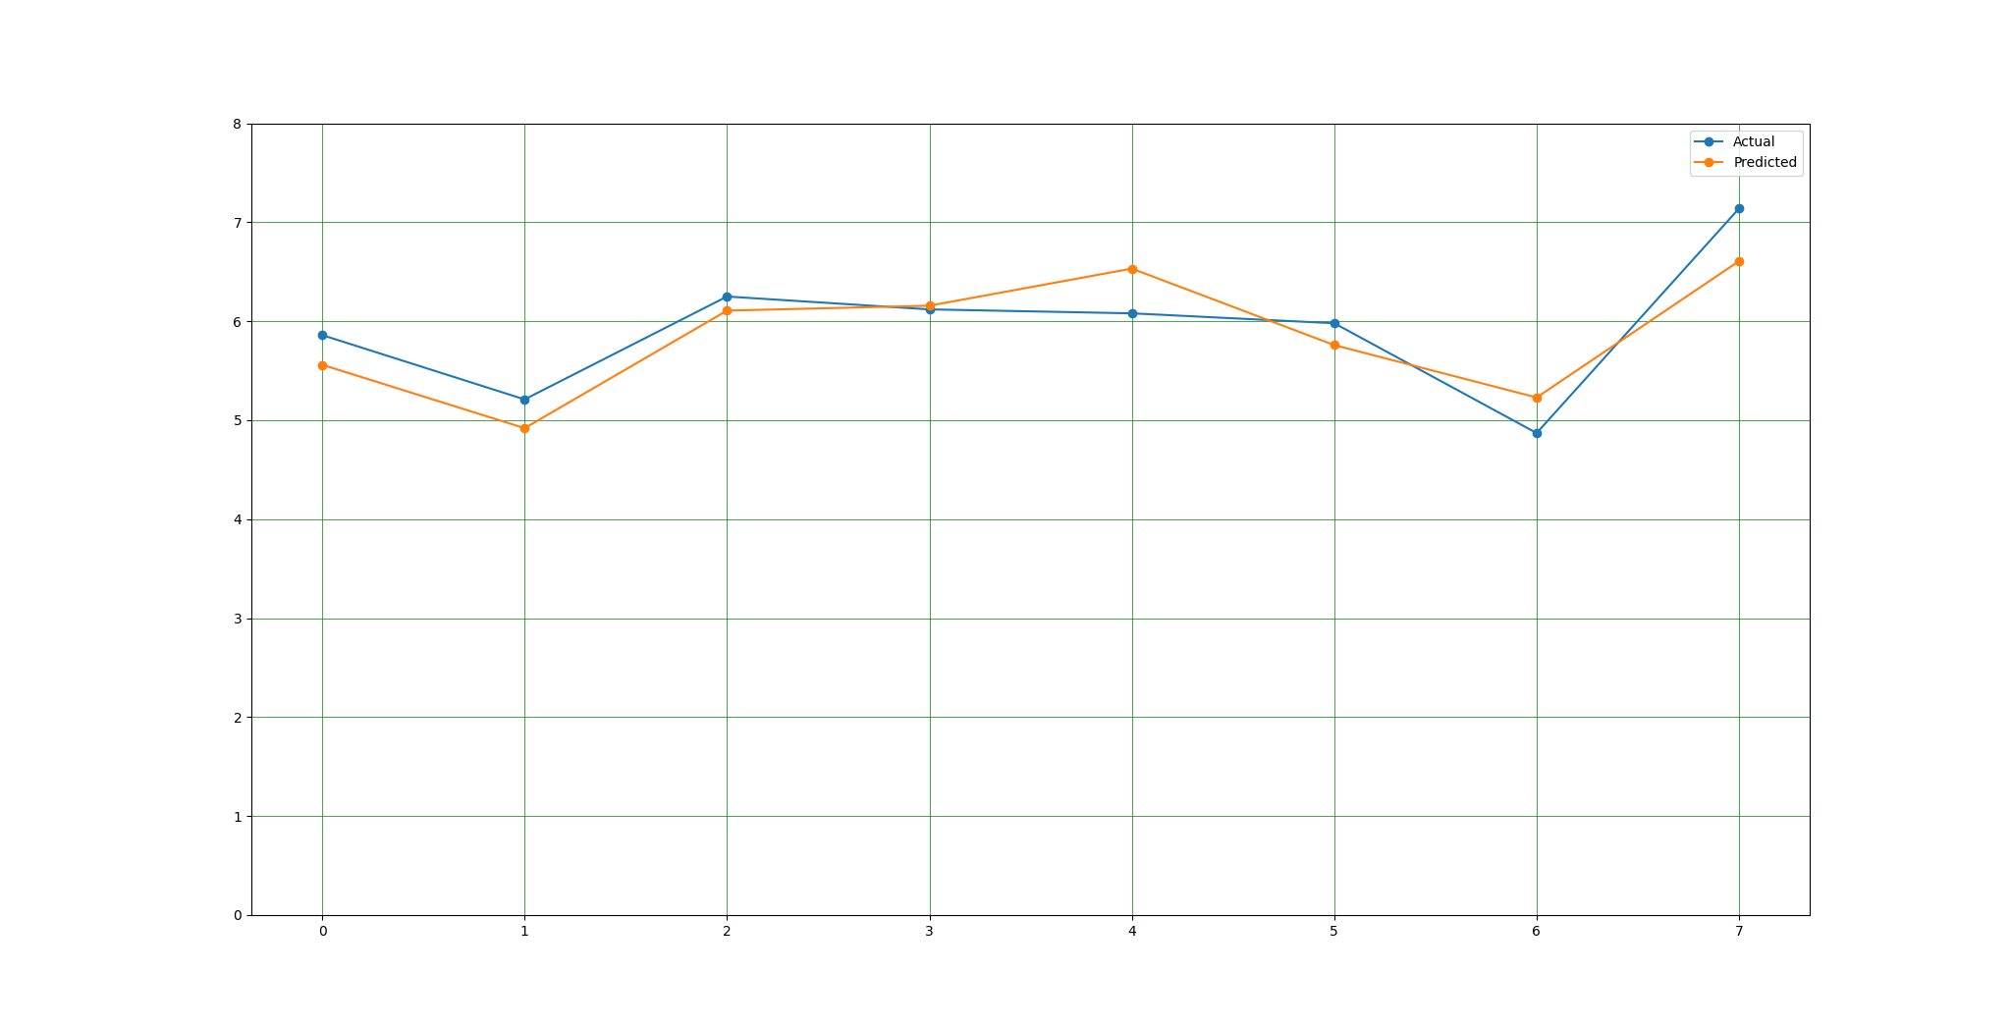
Machine Learning (Arctic Sea Ice Extent Forecast)
Root Mean Squared Error: 0.3281
Variance score: 0.74
R2 value of 0.74 which is very close to 1 with root mean squared error of only 0.3281
Proves good relationship between Carbon Emission and Arctic Sea Ice Extent

Slide 12
Machine Learning (Carbon Emission Timeseries Model)
Tigergraph Cloud Based Graph Database : An easy-to-use, cloud-based graph database built for agile teams.
Google Collaboratory : Colab allows anybody to write and execute arbitrary python code through the browser
PyCharm / Python : To build Machine learning model
Scikit-learn : Regression model python library
Data: All data is collected from NASA Global Climate Change https://climate.nasa.gov/

Slide 13

Thank You

